Slide 1
Linear algebra:
Singular value decomposition
主讲人：常万里

Slide 2

Reference
MIT 18.06 Linear Algebra
https://ocw.mit.edu/courses/mathematics/18-06-linear-algebra-spring-2010/
http://open.163.com/special/opencourse/daishu.html

Slide 3
Index
Singular value decomposition
Dimensionality reduction

Slide 4
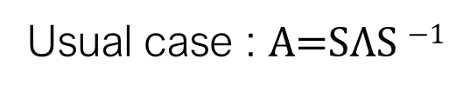
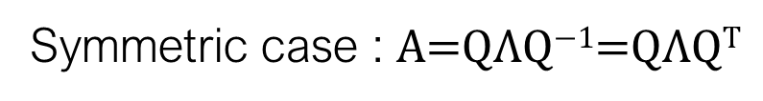
What we learned?
may NOT be Orthogonal
Usual case : $\text{A}\text{=}\text{S}\text{Λ}\text{S} \text{−1}$
A is square matrix !
Symmetric case : $\text{A}\text{=}\text{Q}\text{Λ}\text{Q}\text{−1}\text{=}\text{Q}\text{Λ}\text{Q}\text{T}$
Orthonormal eigenvector
How about more general case?
A is any matrix !

Slide 5
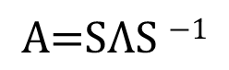
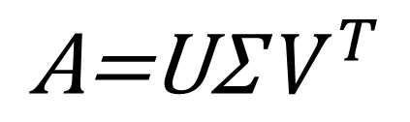
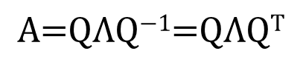
Singular value decomposition
$$\text{A}\text{=}\text{U}\text{Σ}{ V}^{T}$$
where U is orthogonal, Σ is diagonal, and V is orthogonal.
Relationship?
$$\text{A}\text{=}\text{S}\text{Λ}\text{S}\text{ −1}$$
$$\text{A}\text{=}\text{Q}\text{Λ}\text{Q}\text{−1}\text{=}\text{Q}\text{Λ}\text{Q}\text{T}$$

Slide 6
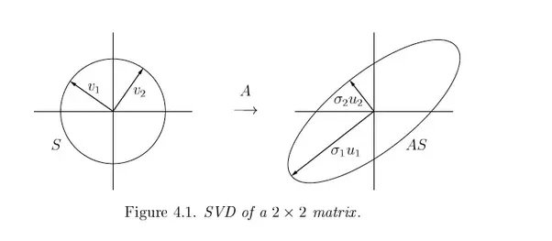
How it works
We can think of A as a linear transformation taking an orthogonal basis V in its row space to another orthogonal basis U in its columns space

Slide 7
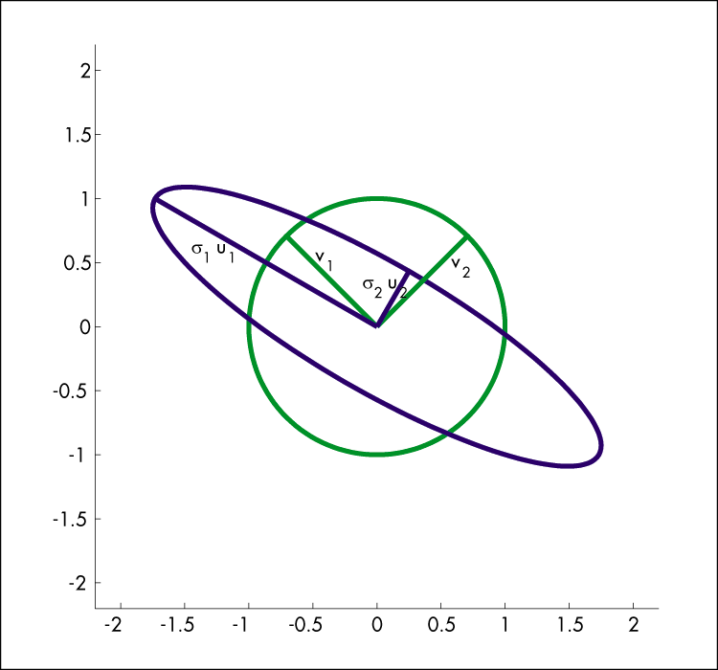
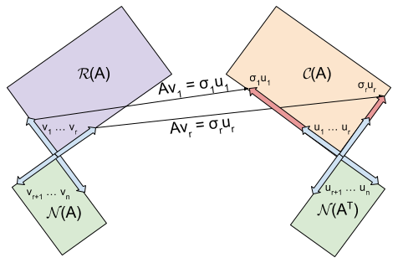

Slide 8
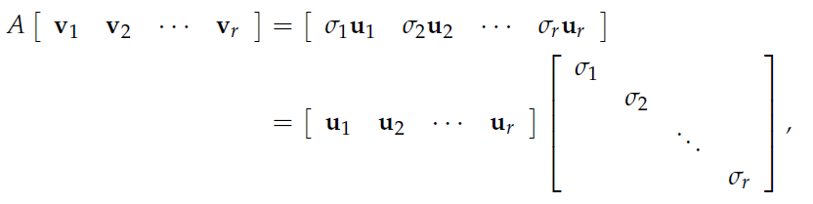
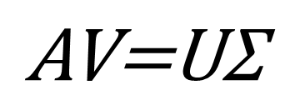
Matrix language
The heart of the problem is to find an orthonormal basis v1, v2, ...vr for the row space of A for which
with u1, u2, ...ur an orthonormal basis for the column space of A.
$$\text{A}\text{V}\text{=}\text{U}\text{Σ}$$

Slide 9
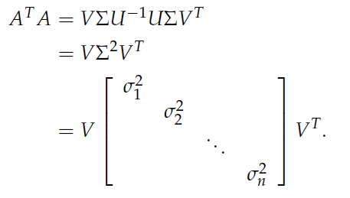
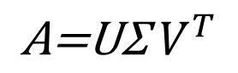
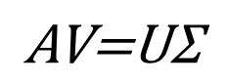
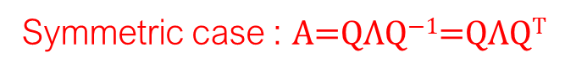

Calculation
$$\text{A}\text{V}\text{=}\text{U}\text{Σ}$$
Since V is orthogonal, we can multiply both sides by V ⁻¹ = V ^{T} to get:
$$\text{A}\text{=}\text{U}\text{Σ}{ V}^{T}$$
we multiply both sides by $\text{A}\text{T}\text{=}\text{V}{\text{Σ}}^{ T}U^{T}$ to get:
V in row space of A
Symmetric case : $\text{A}\text{=}\text{Q}\text{Λ}\text{Q}\text{−1}\text{=}\text{Q}\text{Λ}\text{Q}\text{T}$

Slide 10
Similarly
$\text{AA}\text{T}\text{=}\text{U}\text{Σ}{ V}^{T}\text{V}{\text{Σ}}^{ T}U^{T}=$ $\text{U}{\text{Σ}}^{ 2}U^{T}$
U in col space of A

Slide 11
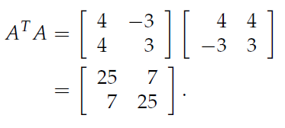
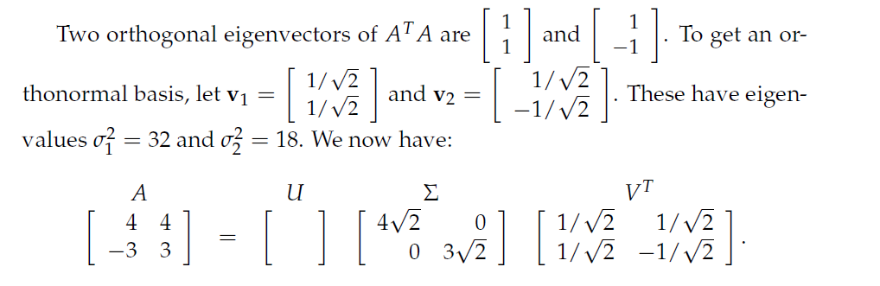
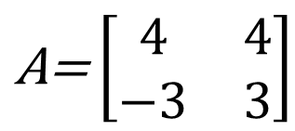
SVD example with square matrix
$$\text{A}\text{=}\left[\begin{matrix}4 & 4 \\ −3 & 3\end{matrix}\right]$$

Slide 12
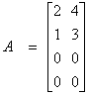
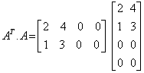
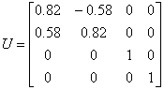
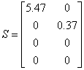
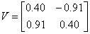
SVD example with common matrix

Slide 13
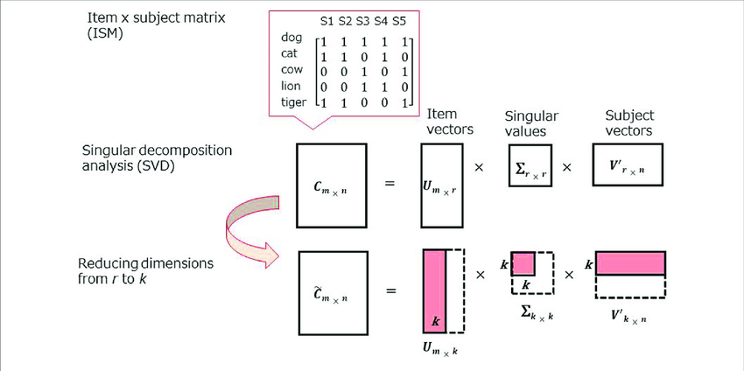
Dimensionality reduction

